Slide 1
Data ANALYSIS OF UNICORN COMPANIES
N.MUKITI

Slide 2
Contents:
Distribution of Unicorn Companies across the world
Funding Trends Over Time for Unicorn Companies
Concentration of Unicorn companies in different Industries
Trends in Unicorn Company Creation
Growth recommendations for unicorns

Slide 3
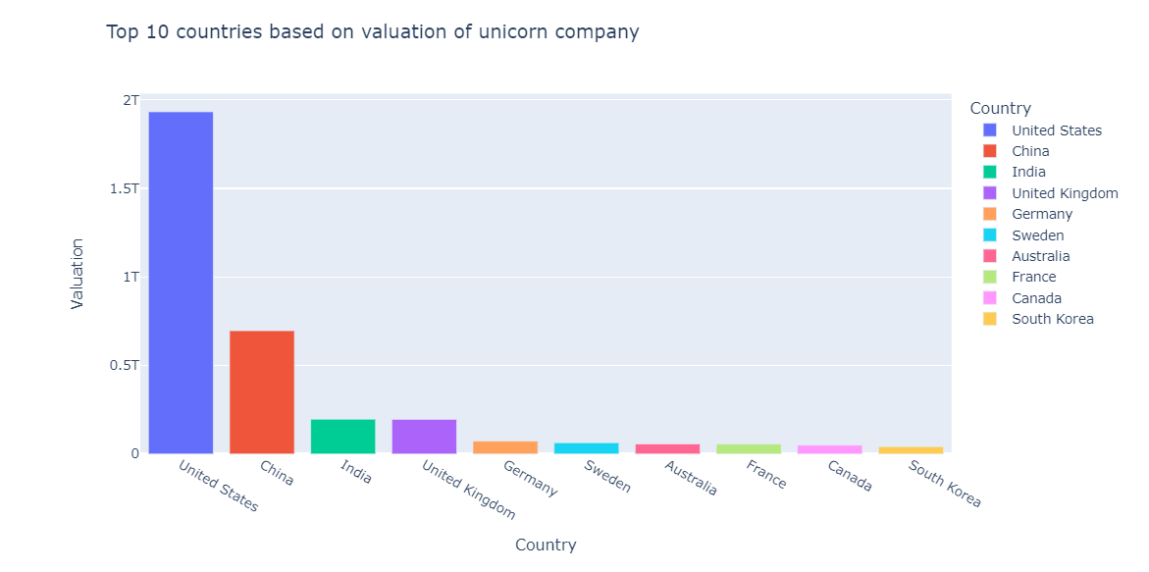
Distribution of Unicorn Companies across the world
Observation: The bar chart of the top 10 countries based on the valuation of unicorn companies reveals that the United States has the highest total valuation, which stands out from the rest of the countries. China is the second country with the highest valuation, and its valuation is considerably lower than that of the United States. Other countries in the top 10 have comparable valuations.

Slide 4
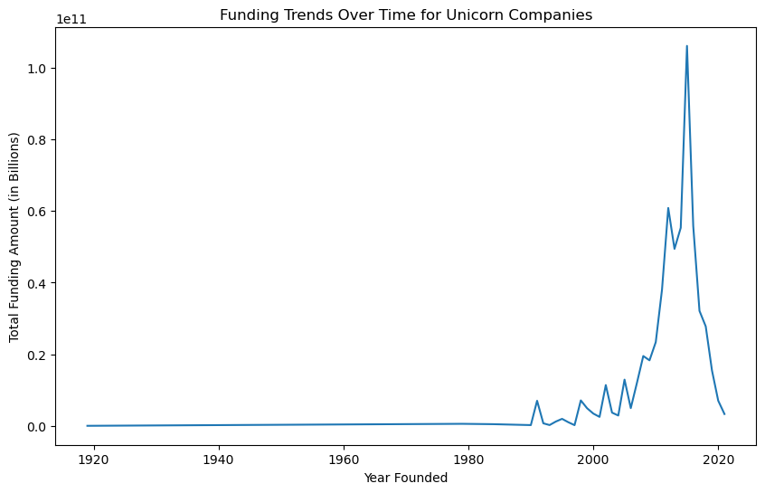
Funding Trends Over Time for Unicorn Companies
Observation: The funding went up from year 2000 and started declining from around year 2019. The decline in funding could have been due to the COVID 19 pandemic.

Slide 5
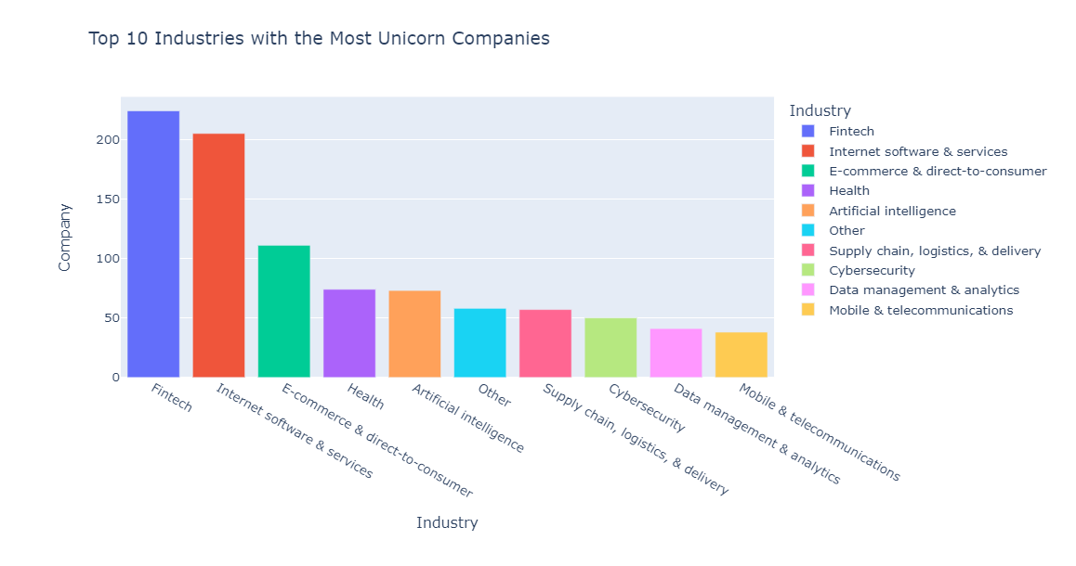
Concentration of Unicorn companies in different Industries
Observation: From the bar chart, we can see that the Fintech, Internet Software & Services industries produce most Unicorn Companies.

Slide 6
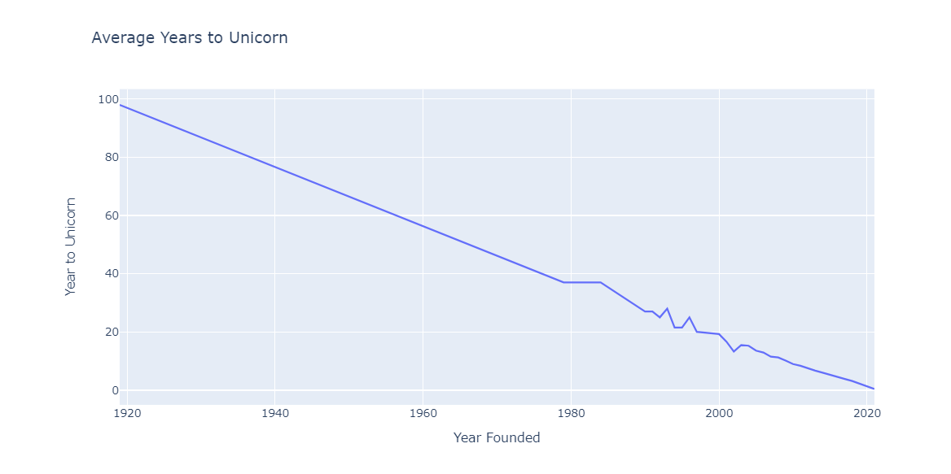
Trends in Unicorn Company Creation
Observation: From the plot above, we can see that the average number of years to unicorn has been decreasing over time, this suggests that it has become easier for companies to achieve unicorn status more quickly.

Slide 7
Growth recommendations for unicorns
Invest in companies with high ROI
As per the analysis, it is recommended to invest in companies with high return on investment (ROI). This can help in generating more revenue in the long run.
Focus on faster growth
The analysis shows that it takes an average of 6-7 years for a company to become a unicorn. However, some companies have achieved this status in less time. Therefore, it is recommended to focus on faster growth strategies to become a unicorn faster.
Expand globally
The analysis shows that the United States and China have the most unicorns. However, there are also unicorns in other countries such as India, the United Kingdom, and Germany. Therefore, it is recommended to expand globally and invest in companies in different countries to generate more revenue.
Partner with top investors
The analysis shows that some investors have funded the most unicorns. Therefore, it is recommended to partner with these top investors to increase the chances of success and generate more revenue.

Slide 8
THE END

